Slide 1
President Dr. Nalin Sharda Vice President Mr. Sushi Sharma Secretary Dr. Santosh Kumar Treasurer Mr. Bill Gupta Com. Member Mr. Davinder Mamik Com. Member Mr. Kasturi Mehra Com. Member Mr. Guruswamy P. Com. Member Mr. S P Matta Com. Member Mr. Kirit Kapadia Past President Dr. Santosh Kumar (2008-2014)
NRISA The Achievers Est: Jan 2008
President’s Welcome Address
17 April 2015
Nalin Sharda

Slide 2
Overview
Welcome
Project INSPIRE Nepal
Next Function

Slide 3
Welcome
All NRISA Members and guests
Artist
Mr Suresh and Mrs Meena Bhandari
moved from Canberra.

Slide 4
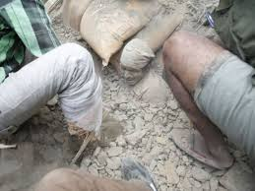
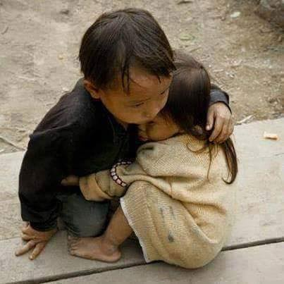
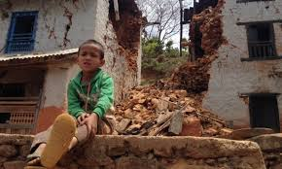
Nepal Disaster: What can we do

Slide 5
NRISA’s INSPIRE Program
INdian Seniors PledgIng
Resources and Effort
Aim is to serve others less fortunate than us
INSPIRE program to facilitate your participation
Other seniors and citizens also most welcome

Slide 6
Project INSPIRE Nepal

Slide 7
Project INSPIRE Nepal

Slide 8
Project INSPIRE Nepal

Slide 9
Project INSPIRE Nepal

Slide 10
Project INSPIRE Nepal

Slide 11
Project INSPIRE Nepal

Slide 12
Project INSPIRE Nepal

Slide 13
Project INSPIRE Nepal

Slide 14
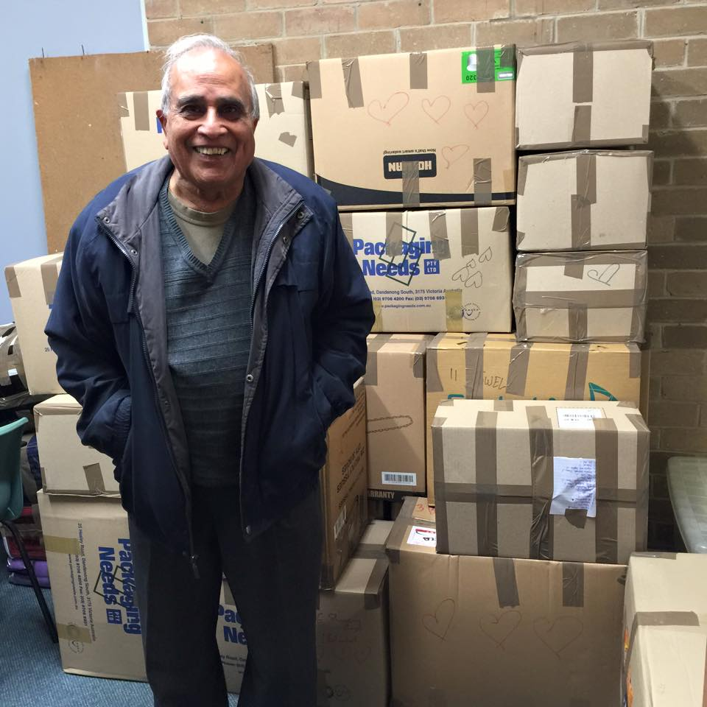
Project INSPIRE Nepal

Slide 15
Project INSPIRE Nepal

Slide 16
Project INSPIRE Nepal
Nepal will need help for another 10 years or more in revive
Power
Water
Roads
School
…….

Slide 17
Project INSPIRE Nepal
What more NRISA can do ?
Raise funds – e.g. 21 June 2015 function
Collect goods
Go there and deliver / install

Slide 18
Project INSPIRE Nepal
Funds raised will be used under NRISA supervision
Your suggestions are welcome
We are considering:
Solar power
Water purification

Slide 19
Project INSPIRE Nepal
Light Up Australia Foundation – LUAF Inc.
(Founder: Prof. Chandra Bhuta)
Originated in Canada by Prof Dave Irvine Halliday
Technology
WLED’s Lights (White Light Emitting Diode)
People
Installation and training of members of communities

Slide 20
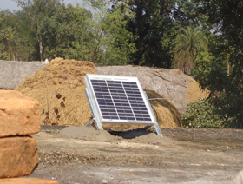
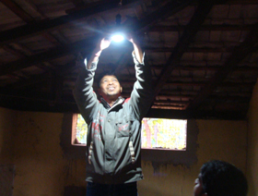
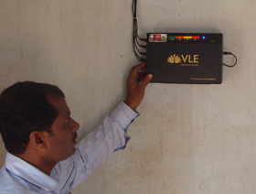
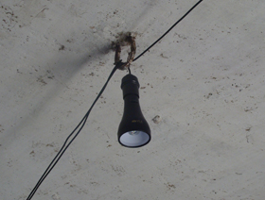
Project INSPIRE Nepal

Slide 21
Project INSPIRE Nepal
NRISA Plan:
Collect funds
Buy best value products
Go and deliver / install items
No overheads
Persons going will bear the cost of travel, accommodation and personal food etc.

Slide 22
Thanks

