Slide 1
President Dr. Nalin Sharda Vice President Mr. Sushi Sharma Secretary Dr. Santosh Kumar Treasurer Mr. Bill Gupta Com. Member Mr. Davinder Mamik Com. Member Mr. Kasturi Mehra Com. Member Mr. Guruswamy P. Com. Member Mr. S P Matta Com. Member Mr. Kirit Kapadia Past President Dr. Santosh Kumar (2008-2014)
NRISA The Achievers Est: Jan 2008
President’s Welcome Address
21 June 2015
Nalin Sharda

Slide 2
Overview
Welcome
Project INSPIRE Nepal
What has been done
What we can do more

Slide 3
Welcome
All NRISA Members and guests
Especially if you have come to NRISA for the first time.

Slide 4
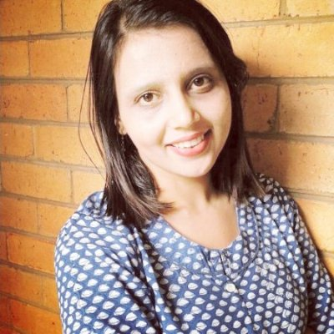
Welcome
Ms Mosiqi Acharya (SBS radio)
Ms Mosiqi Acharya has been a Journalist since 2003. She is currently with SBS Radio, and has worked with The University of Melbourne and Australia India Institute's The Election Watch, The Age, and Australian Institute of International Affairs in Australia, as well as with Headlines Today, NewsX, Radiocity, CNN IBN, Mid-day and The Times of India, in India.

Slide 5
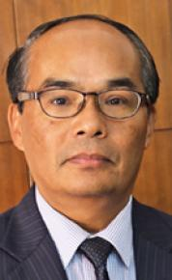
Welcome
Mr. Chandra Yonzon
Hon. Consul General of Nepal,
Victoria
Mr Chandra Yonzon is the founder, and CEO of the Royal Gurkhas Institute of Technology (RGIT) Australia. He is the founder of the popular Gurkhas chain of Nepalese restaurants in Melbourne. Mr Yonzon is a well-known public figure and leader within the Nepalese community in Australia. Currently he is the Honorary Consul General of Nepal for Victoria.

Slide 6
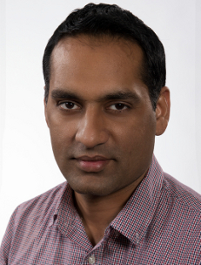
Welcome
Mr. Jasvinder Sidhu
Mr. Jasvinder Sidhu is an adviser to Hon. Daniel Andrews, Victorian Premier, who said, “Jasvinder Sidhu is a strong voice for the Indian community and I’m proud to take his advice”.
With eight years of university teaching experience and a double Master’s Degree from RMIT University, Mr Singh has presented research findings at conferences across Europe, North America and the Asia-Pacific.
Mr Sidhu serves on boards of many community associations, is a regular commentator on ethnic Indian radio stations and writes for Indian newspapers.
Mr Sidhu’s major community projects include support programs for isolated migrant elders, refugees and victims of domestic violence, and breakfasts for school children.

Slide 7
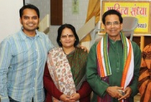
Welcome
Dr. Bageshari Chakradhar
Dr. Bageshri Chakradhar is a poetess and writer, who has Masters in Music and Hindi, with a PhD in Hindi. She is a Hindi lecturer in Delhi University. Bageshri ji is the daughter of famous poet Kaka Hathrasi and the wife of Padmashri Dr Ashok Chakradhar.

Slide 8
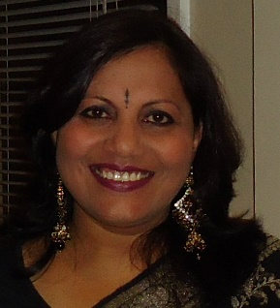
Welcome
Mrs. Rekha Rajvanshi
Mrs. Rekha Rajvanshi is a school teacher, Hindi writer and poet. She has a Masters in Psychology and Education. Rekha ji is teaching Hindi at the University of Sydney. She is an approved All India Radio Delhi artist and contributed segments for SBS Hindi and Indian Link Radio. She has authored 5 books and is working on her new Ghazal book. Rekha was recognised by many organisations in India and Australia. She received a national level AUSIT Excellence in Translation Award for translating Aboriginal dreamtime stories in Hindi. She will entertain you with her lilting poetry.

Slide 9
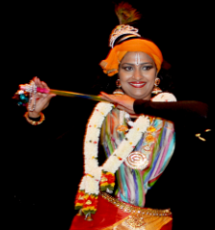
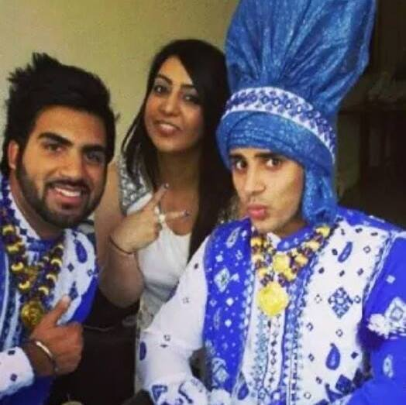
Welcome
Ms Kanka Sivaraman
Ms Kanka Sivaraman is a passionate dancer, while being a mother of 2. She learnt her dance in her early years. She has been in Melbourne for the past 10 years.
Rohit Dhillon, Baljeet Dhillon, Priya Dhillon, Sukhdeep Batra
They members of the group called “Melbourne Bhangra Regiment”, which was established in 2012. Their team has performed at various events and festivals. They competed first time in NSW Bhangra Down under and their team won third place. Now this year they are preparing for the biggest Gala Competition where 10 teams are going head to head.

Slide 10
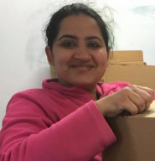
Welcome
Ms Nibedita Baral
Ms Nibedita Baral is a Program Manager at Nepali Sanchar Radio and a Foundation member of Bibeksheel Nepali Party.
Mrs. Pratima Francis
Mrs. Pratima Francis is a highly educated professional working with the Victorian Government. She has been a very active member of various Melbourne community organisations, and a regular participant in social programs.

Slide 11
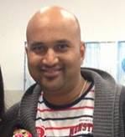
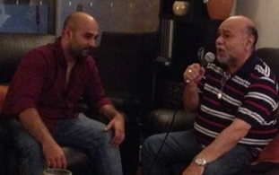
Welcome
Mr. Prabhakar Agraja
Mr. Prabhakar Agraja is a qualified lead auditor in Quality Management Systems specializing in the Vocational and Education sector of Australia. He is regular performer at Melbourne events.
Mr. Mohan and Sandeep Mahadevan
+ Srikanth Srinivasan (piano)
They will perform is a Piano Medley of old & new songs - Srikanth Srinivasan, Sandeep Mahadevan, and Sandeep’s father Mohan Ji. Pls give them a big round of applause, this is Srikanth's first performance in Melbourne and it’s the first time Sandeep and his father are performing on stage together.

Slide 12
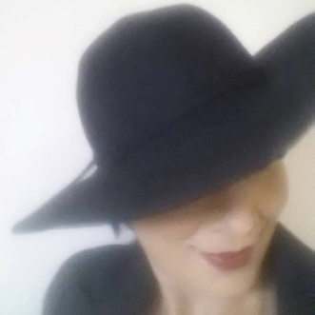
Welcome
Mrs Sunita Sethi
Mrs Sunita Sethi is a multi-talented personality. She has studied Masters in Music from Delhi University and is a classical dancer. Recently she has also acted in various short films. She has introduced a cookery show on SBS channel sharing her various tried-and-tested recipes with the audiences. She has enthralled the audiences at many NRISA functions before, and once again she will entertain you with her “Kokil” voice.

Slide 13
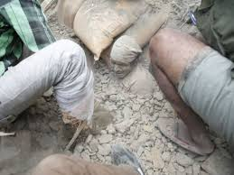
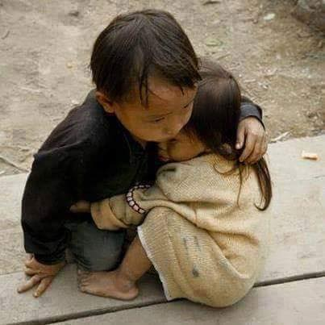
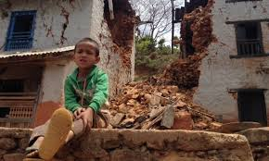
Nepal Disaster: What can we do

Slide 14
NRISA’s INSPIRE Program
INdian Seniors PledgIng
Resources and Effort
Aim is to serve others less fortunate than us
INSPIRE program to facilitate your participation
Other citizens also most welcome
Together we can do a lot more.

Slide 15
Project INSPIRE Nepal

Slide 16
Project INSPIRE Nepal

Slide 17
Project INSPIRE Nepal

Slide 18
Project INSPIRE Nepal

Slide 19
Project INSPIRE Nepal

Slide 20
Project INSPIRE Nepal

Slide 21
Project INSPIRE Nepal

Slide 22
Project INSPIRE Nepal

Slide 23
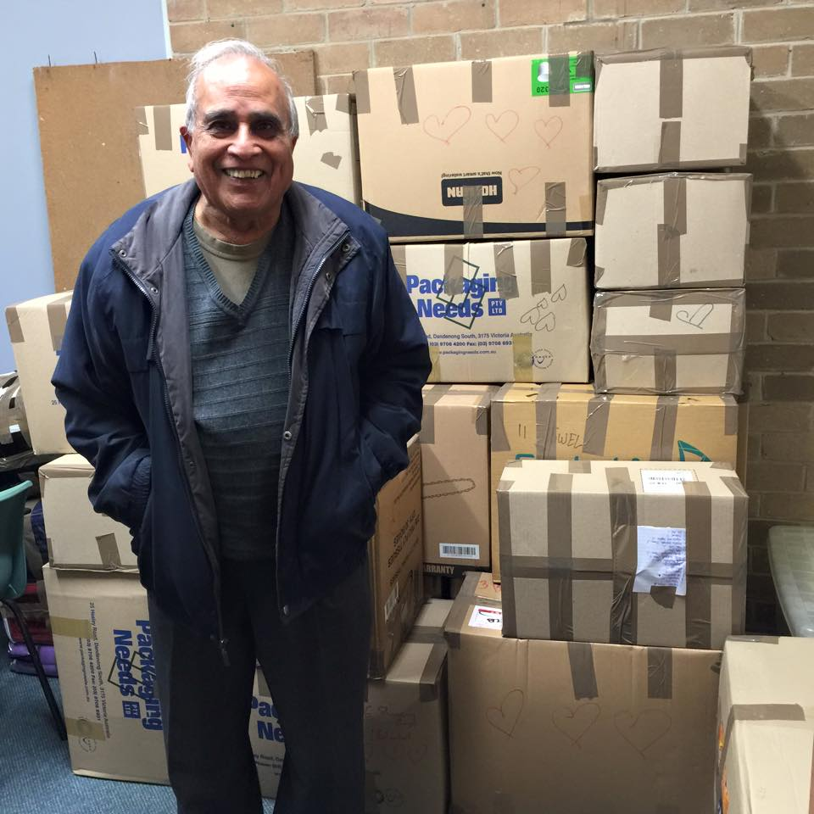
Project INSPIRE Nepal

Slide 24
Project INSPIRE Nepal

Slide 25
Project INSPIRE Nepal
Nepal will need help for another 10 years or more in revive
Power
Water
Roads
School
…….

Slide 26
Project INSPIRE Nepal
What more NRISA can do ?
Raise funds
Collect goods
Go there and deliver / install

Slide 27
Project INSPIRE Nepal
Funds raised will be used under NRISA supervision
Your suggestions are welcome
We are we considering:
Solar power
Water purification
Education

Slide 28
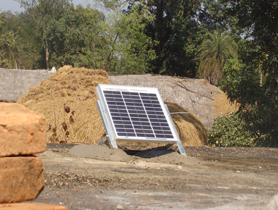
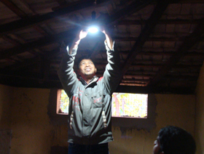
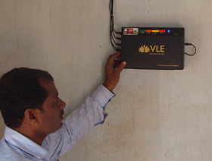
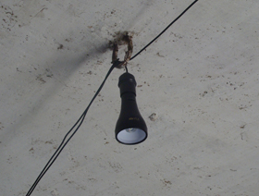
Project INSPIRE Nepal

Slide 29
Project INSPIRE Nepal
NRISA Plan:
Collect funds
Buy best value products
Go and deliver / install items
No overheads
Persons going will bear the cost of travel, accommodation and personal food etc.

Slide 30
Project INSPIRE Nepal
We Acknowledge
Deepashree Shah
Vikas Nayak
Nibedita Baral

Slide 31
Project INSPIRE Nepal Evidence

Slide 32
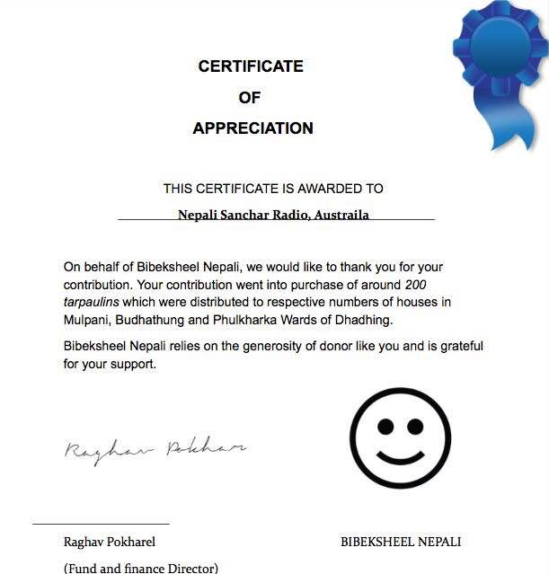
Project INSPIRE Nepal Evidence

Slide 33
Project INSPIRE Nepal
We Acknowledge
Friends of the Children Organisation: $5000
Mr. Purshottam Mishra: $1000
Sharda Kala Kendra: $1000
The Om Music Group Australia: $500
Dr Suresh and Mrs Vijaylaxmi Gupta: $200
Mr. Jay Mulchandani: $100

Slide 34
Project INSPIRE Nepal Evidence

Slide 35
Project INSPIRE Nepal Evidence

Slide 36
Thanks
Come and join hands
Be inspired and INSPIRE
Enjoy the program

