Slide 1

Energy
Understand it, Control it and Save

Slide 2
In this workshop...
Victorian Energy System
Reading Bills
Concessions
Kilo-what?
Smart Meters
Flexible Pricing
Choosing a better electricity deal
Door Knocking & Solving Problems
Saving Energy

Slide 3
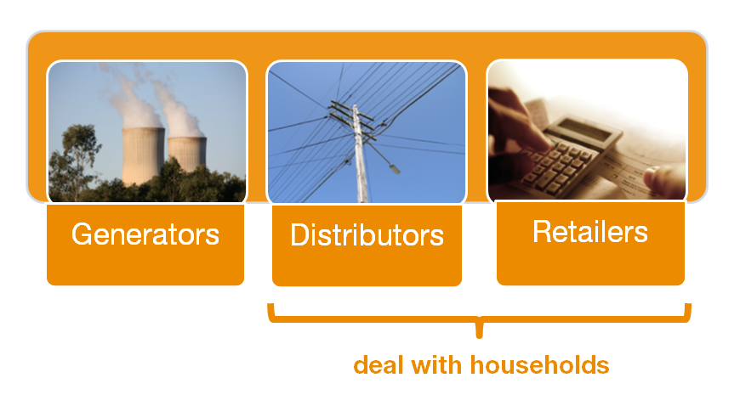
Victorian Energy System
Who’s who?
Notes:
3 types of energy company:
Generators make the electricity or gas
Distributors own and look after the poles, wires and pipelines
Retailer are the company that send you a bill

Slide 4
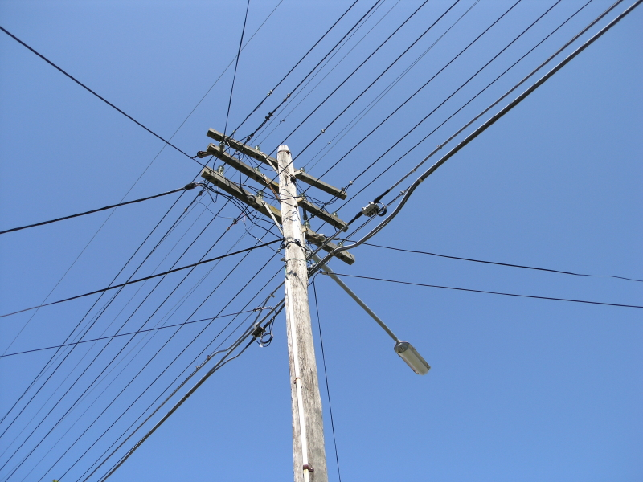
Victorian Energy System
Distributors
Talk them about:
Power interruptions
Emergencies
Meter issues
Special electricity supply needs
(like a life support machine)
Notes:
There is no choice of distributor for customers – they are fixed based on where you live
Look for the ‘faults and emergencies’ phone number and name on the front page of a bill to work out who your distributor is

Slide 5


















Victorian Energy System
Retailers
Talk to them about:
bills
getting connected
energy deals
moving house
getting concessions
problems or complaints
Notes:
Retailers are the companies that send bills
In Victoria, at present, there are around twenty different retailers

Slide 6
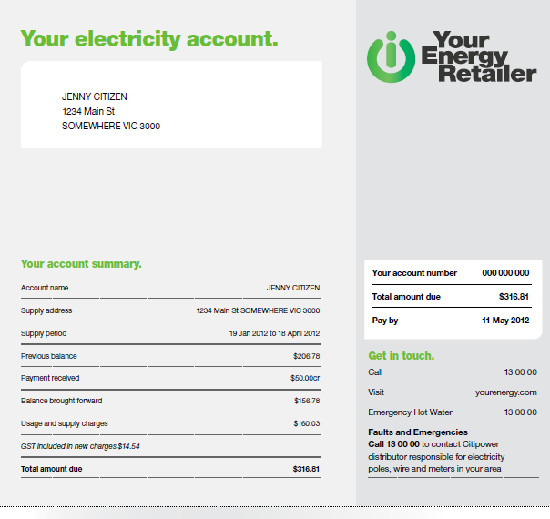
Reading Bills
Notes:
Bills can have information in different places but, by law, must have the same types of information on them, including information about the account, prices, energy use, and paying bills
It is good to check the following:
Is the bills yours? – check the name and address
Check the total amount due – this can be different from the amount for the billing period
The amount for the billing period is recorded separately – usually under ‘current’ or ‘total’ charges for the period
Check that your payments are recorded
Your distributor is listed where it says ‘faults & emergencies’

Slide 7
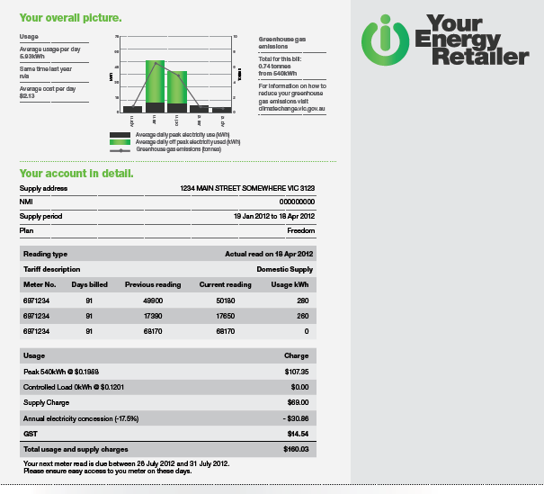
Reading Bills
Notes:
Check:
Check your usage over time – is it more or less than the same period last year?
The supply address is correct
The number of billing days – are your bills monthly or quarterly. If it’s a high bill, is it more days than the last bill you received?
Total Usage – this is the total amount of electricity you used in the billing period
Bills also contain information about the price you pay for energy – there are 2 charges:
Supply charge which is a set amount for each day to pay for energy supply
Usage charges for the amount of electricity or gas the customer used - written on the bill as cents per kilowatt hour (c/kWh) for electricity and cents per megajoule (c/MJ) for gas
Don’t forget to check to ensure you are receiving concessions
Bills also contain information on the average cost and average usage per day. To use My Power Planner – you’ll need to know average usage – the average number of kWh used per day - as well as the dates of the billing period (i.e. 1 July to 29 July 2014)
The billing period is also shown – you’ll need this info to use My Power Planner

Slide 8
Concessions & Grants
The 2 main concessions
help households spending
$2,000 on gas and electricity
save around $350 a year
Notes:
The second way to save is to make sure you get any concessions that you are eligible for.
People who are on low incomes can often get government discounts (known as a ‘concessions’) on their energy bills

Slide 9
Concessions & Grants
17.5% off electricity bills
Annual Electricity Concession
17.5% off winter gas bills
Winter Gas Concession (1 May to 31 October)
Notes:
The main two concessions in Victoria provide a discount of 17.5% of your gas and electricity bills (that’s a saving of $350 for households that pay about $2000 per year)
An Excess Electricity Concession has been recently introduced. Households with annual electricity bills of more than $2,763 (for the period – 1 December 2013 to 30 November 2014) will need to apply for the Excess Electricity Concession to continue to receive the concession on electricity costs above these amounts

Slide 10
Concessions & Grants
Service to Property Charge Concession
Non-Mains Energy Concession
Medical Cooling Concession
Controlled Load Electricity Concession
Life Support Concession
Electricity Transfer Fee Waiver
Notes:
Other concessions:
Service to Property Charge Concession
a reduction on the electricity supply charge for households with low electricity consumption
Non-Mains Energy Concession
annual rebate for LPG for domestic heating or cooking
Medical Cooling Concession
17.5 % discount off electricity costs (from 1 November to 30 April) for those with medical conditions such as Multiple sclerosis ,Parkinson's disease, fibromyalgia and Motor Neuron disease
Controlled Load Electricity Concession
13% reduction on controlled load usage (electric hot water or slab heating)
Life Support Concession
for households using life support machines, such as an oxygen concentrator or haemodialysis machine
Electricity Transfer Fee Waiver
a waiver of the fee that is payable when there is a change of occupancy
Visit DHS at http://www.dhs.vic.gov.au/for-individuals/financial-support/concessions/energy for more information

Slide 11
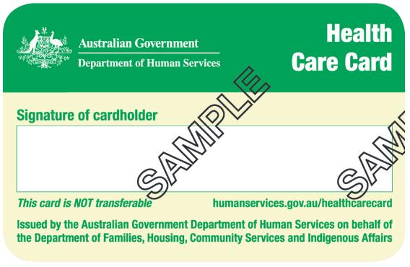
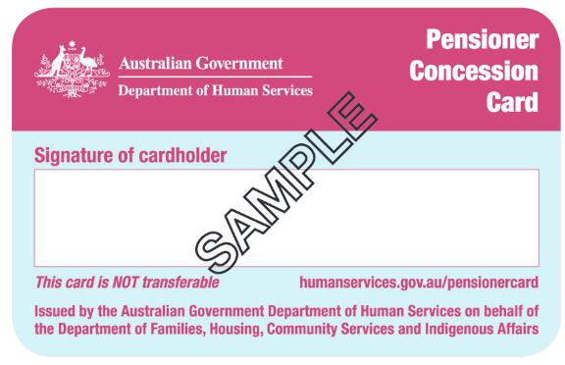
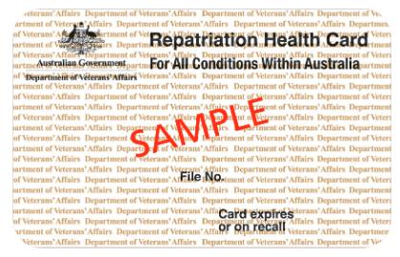

Concessions & Grants
Concessions Information Line on 1800 658 521, or
The company that sends your bills
Notes:
To be eligible for concessions, you usually need to have one of these cards – a pensioner concession card, health care card, or a veterans’ affairs gold card
To find out which concessions you are eligible for, call the Department’s Concessions Information Line on 1800 658 521 or contact the company that sends your bills
Applying for concessions is usually easy, and you can often do it over the phone

Slide 12

Concessions & Grants
Check that concessions are recorded on every bill
Notes:
To get your concessions:
make sure that the name and address on your energy account and on letters from Centrelink are exactly the same
check every bill to make sure your concessions have been included
Call the company that sends your bills and tell them when your card details change

Slide 13
Concessions & Grants
Utility Relief Grant Scheme (URGS)
Provides up to $500 each for:
Electricity
Gas
and water
If you have had financial hardship recently contact the company that sends your bill and ask about URGS
Notes:
For people with a utility debt there’s also government grant called the Utility Relief Grant Scheme (URGS)
Available for Gas, Electricity AND Water
You don’t necessarily need a concession card to apply for URGS – you just need to be registered with the hardship program of your energy company
To apply you need to have had some financial difficulty, such as:
an increase in energy or water use due to a fault etc.
a recent decrease in your income (e.g. job loss)
high unexpected expenses on essential items
spending more than 30 per cent of household income on housing
spending more than 10 per cent of household income on utilities
To apply for a URGS you need to fill out an application form, which you can get from the company that sends your bills

Slide 14
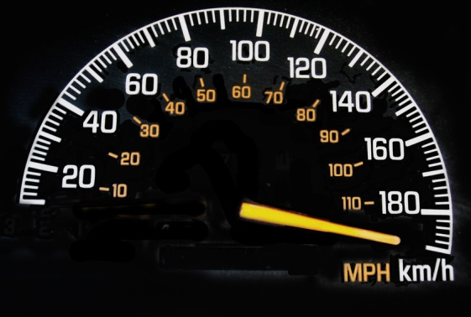
kilo-What?
1000 metres = 1 kilometre or 1km
1000 Watts = 1 kiloWatt or 1kW
If you use 1kW for 1 hour it means you’ve used 1kWh of electricity
Notes:
One way to check your electricity use is to look at the number of kiloWatts you have used on your bill

Slide 15
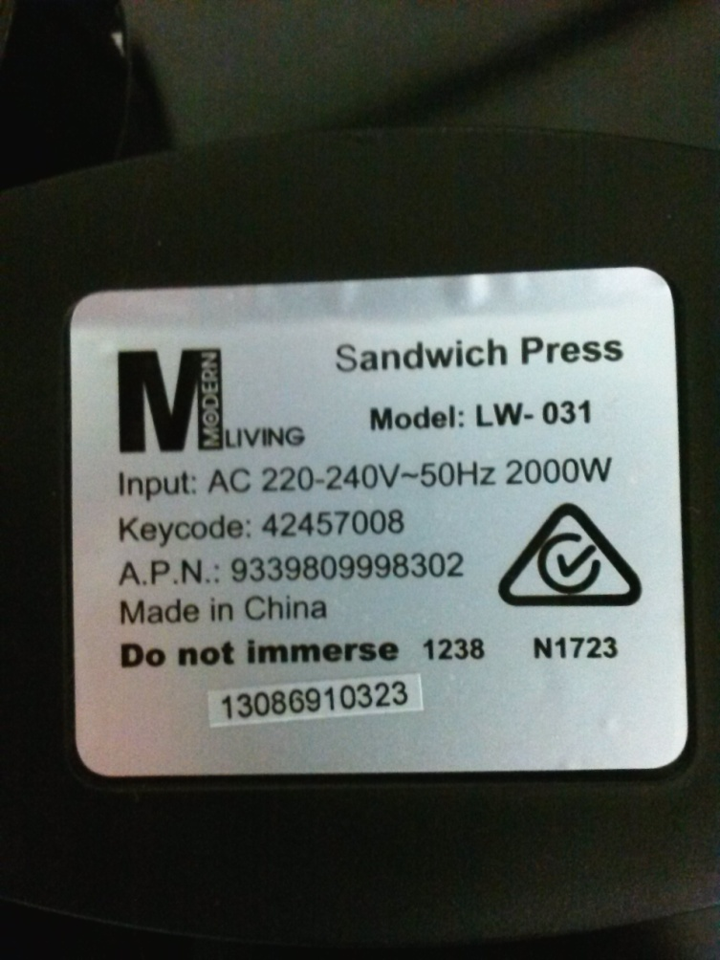
kiloWatts
1 hour = 2000Wh
2 hours = 4000Wh
3 hours = 6000Wh
4 hours = ??
Notes:
Every appliance in your house uses a different amount of electricity
Most appliances will tell you how much electricity they use. Look for the silver label on the back or it might be written into the metal or plastic on the appliance
This appliance uses 2000W of power at any moment. This means it consumes 2kWh for every hour that it is used. So that’s 4kWh in 2 hours, 6kWh in 3 hours
Basically, you get charged for how long you use each appliance

Slide 16
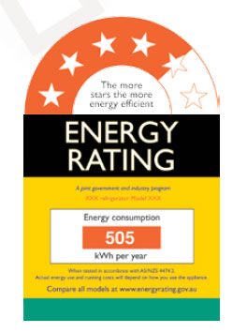
kiloWatts
Energy Rating Labels tell you how much electricity is used
505 kWh per year
Notes:
Energy labels also tell you how much electricity is used
This fridge uses 505kWh each year

Slide 17
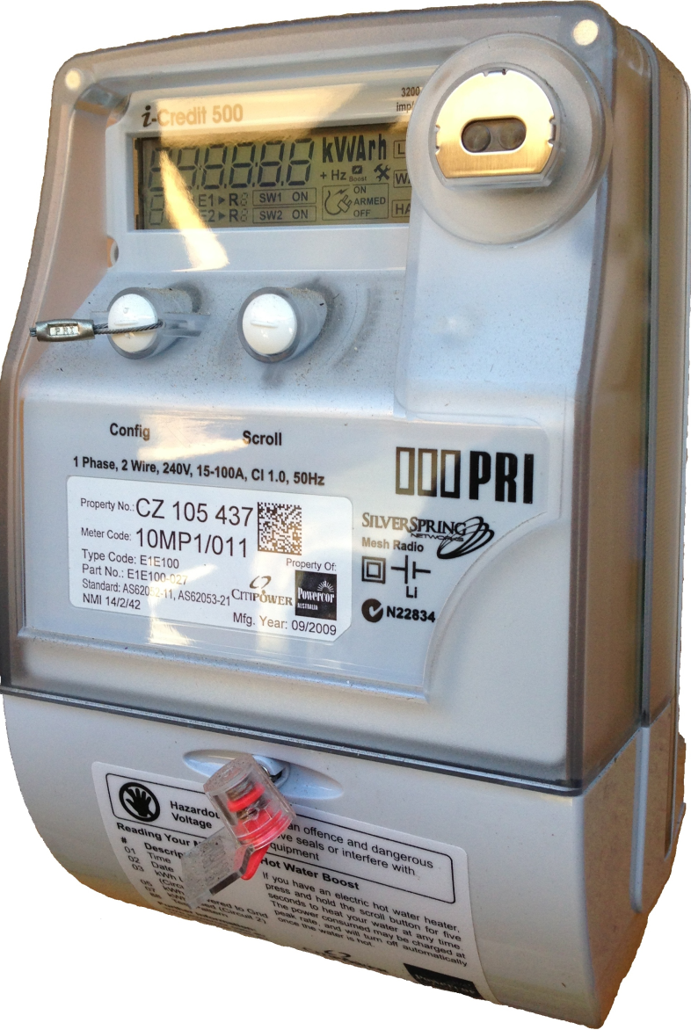
Smart Meters
The basics...
Record electricity use every 30 minutes
send this information to the distribution company
are owned by the distribution company, not the household
Notes:
Since 2009, Victoria has been replacing its old electricity meters with new smart meters. That process of changing everyone over to smart meters is almost finished
Before smart meters, a meter reader would visit your house and record the total amount of electricity used through the meter. This reading was compared to the previous reading to work out how much electricity you had used in the billing period (the previous 90 Days)
Smart meters are different because they measure how much electricity a household has used every half hour. Smart meters record this information and then send it wirelessly and automatically to the electricity company
Just like the old electricity meters, you don’t actually own the smart meter - it is owned and managed by a distribution company, which collects the information from the smart meter and then they pass that information on to your retailer, and the retailer uses that information to send you a bill

Slide 18
Smart Meters
Common questions
‘How much do smart meters cost?’
‘Are they safe?’
‘How do I know my information will be kept private?’
‘Do I have to have one?’
Notes:
Consumers have been paying for the cost of smart meters since 2010 (in 2013, each electricity account holder paid $110 - $170). This cost, like the cost of poles and wires, has always been included in electricity bills
Safety - smart meters contain a type of 'wireless communication device.' After measuring electricity use, smart meters store this information and send it to the electricity company wirelessly, using short bursts of radio waves—usually for a few seconds per day
There are rules about the safety of wireless communication devices such as smart meters and mobile phones. Smart meters have been independently tested to see if they comply with this rule - the electromagnetic radiation from smart meters is well below the limits in the rule and the tests showed that smart meters cause less electromagnetic exposure than many other household items like mobile phones and baby monitors
Privacy - Smart meters collect a lot of information about electricity use. There are rules about how personal information like smart meter information is kept private. The rules state that electricity companies:
· must protect your information from unauthorised access
· must give you your information if you ask for it, and
· must not share your information with anyone else unless you agree first
Smart Meters have security features to stop other people from tampering with it and the information is protected with a password, and when the information is sent wirelessly it is coded so others can't understand it
The Victorian Government's policy is that all Victorian households and small businesses will have their old meter replaced with a smart meter

Slide 19
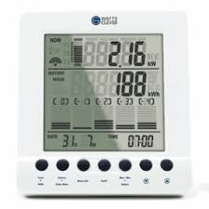
In-Home Displays & Web Portals
In home displays (IHDs)
Show you how much electricity is used now
You need a smart meter
Cost around $50 - $300
Notes:
One of the benefits of smart meters is they provide accurate information on how you use electricity:
This information can be used in the My Power Planner website to accurately estimate your electricity costs
The information can also be shown on an in-home display or a web portal
In-Home Displays (IHDs) are small, portable devices that take information from the smart meter and display it on a screen. The screen shows you how much electricity you are using at the moment. Some in-home displays also tell you how much the electricity is costing you
In-home displays cost between $50 and $300

Slide 20
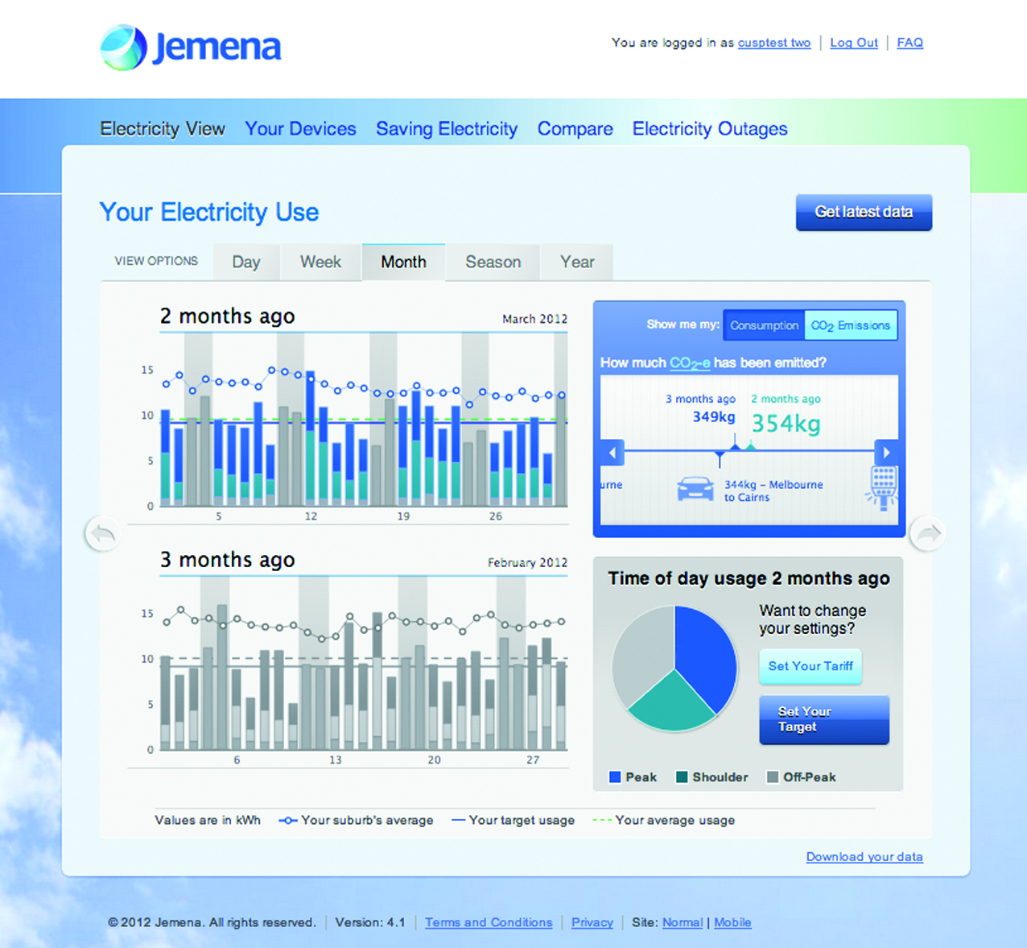
In-Home Displays & Web Portals
Energy Web portals
Show how you use electricity
Help to budget for bills
Give tips and help save electricity
Notes:
Web portals are websites that let you look at the electricity information for your house. They work by connecting up with the data that from your smart meter. The portal displays data in a way that’s easy to understand.
Energy web portals are offered by some energy companies and some distributors (the people you contact when their is a blackout), and each one is different, you have to be a customer of one of those companies to use their portal
Not all companies have a portal. Whether you can use a distributor’s portal depends on whether you live in the distributor’s area
If you are a customer of one of the companies with a portal, you’ll need to sign up to use it. You will need a computer with an internet connection, a recent electricity bill (to get your account details) and an e-mail address. It should be free, but it might take a day or so for the portal to be set up

Slide 21
In-Home Displays & Web Portals
https://myhomeenergy.com.au
Notes:
Web portals are websites that let you look at the electricity information for your house. They work by connecting up with the data that from your smart meter. The portal displays data in a way that’s easy to understand.
Energy web portals are offered by some energy companies and some distributors (the people you contact when their is a blackout), and each one is different, you have to be a customer of one of those companies to use their portal
Not all companies have a portal. Whether you can use a distributor’s portal depends on whether you live in the distributor’s area
If you are a customer of one of the companies with a portal, you’ll need to sign up to use it. You will need a computer with an internet connection, a recent electricity bill (to get your account details) and an e-mail address. It should be free, but it might take a day or so for the portal to be set up

Slide 22
Flexible Pricing
Flat pricing - a traditional electricity bill
‘daily supply charge’ – a set amount for each day
a ‘usage charge’ – a charge for the amount of electricity used
Notes:
You may notice that My Power Planner shows some deals as Flexible Pricing
Flexible pricing is now available in Victoria
Normally bills contain two sets of charges:
Supply charge which is a set amount for each day to pay for energy supply
Usage charges for the amount of electricity you use
Most people are used to paying a set prices for the electricity they use – that is the price for each bit of electricity is the same, no matter when it was used

Slide 23
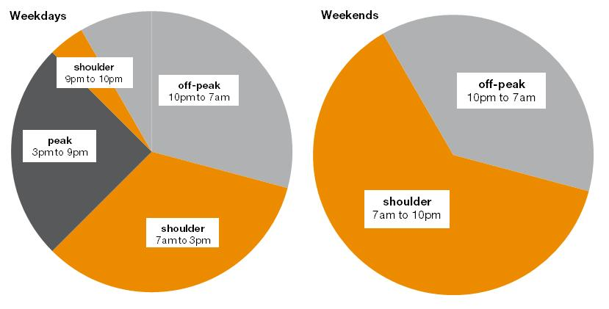
Flexible Pricing
Flexible pricing time periods
Notes:
Flexible pricing is different – the cost of electricity is different depending on the time of day and the day of the week it is used
In this flexible pricing deal shown has three different time periods, each with its own price:
Peak period - where electricity costs the most money
Shoulder period when it costs a bit less
Off-peak period when electricity is at its cheapest
Some flexible pricing deals will use these same periods, others will be different but they should generally follow the pattern of being cheapest overnight and most expensive in the afternoon and evening on a weekday
Some people already have off peak rates for appliances, such as hot water or slab heating. Flexible pricing is different - all appliances are charged at lower off peak rates overnight, not just the hot water
(Some customers will already have time of use rates – an off peak and peak rate often shown on bills GH/GL or WINNER tariff)

Slide 24
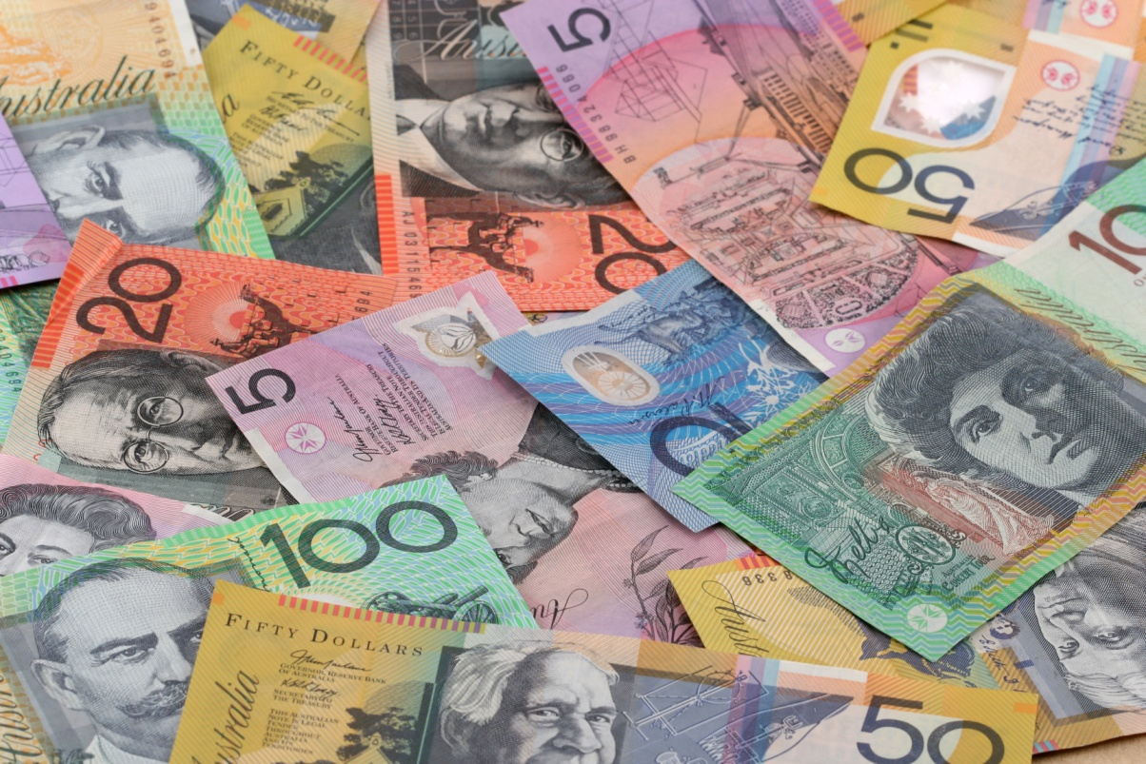
Flexible Pricing
The million dollar question - who can save with flexible pricing?

Slide 25
Break...

Slide 26
Choosing a Good Deal
http://www.abc.net.au/tv/thecheckout/clips/
Notes:
First, check with the company sending you bills to see if you must pay an exit fee or if they’ll match the new deal
Say the name of the plan you want
You will also be asked for your name, address, phone number and birth date, as well as details for any extra account holders
The person from the energy company will read or play a recording of the terms and conditions and ask you whether they understand and agree to them. If you have questions or if anything is unclear, you should ask the operator about it
Don’t forget to give your concession card details, if you have one
The energy company will organise the rest – you do not need to contact your old energy company
Remember, it is ok to change your mind - you have a 10 day ‘cooling-off period’. During this time, if you change your mind you can contact the energy company to let them know

Slide 27
Choosing a Good Deal
Households can save up to
$715 - $920 a year on electricity
by switching from the worst to the best offer
– St Vincent de Paul
Notes:
A recent report by St Vincent de Paul (http://www.vinnies.org.au/icms_docs/192728_Victorian_Energy_Prices.pdf) found that “Households with typical electricity consumption (4,800kWh) can save up to $715 - $920 per annum” by switching from the worst to the best offer

Slide 28
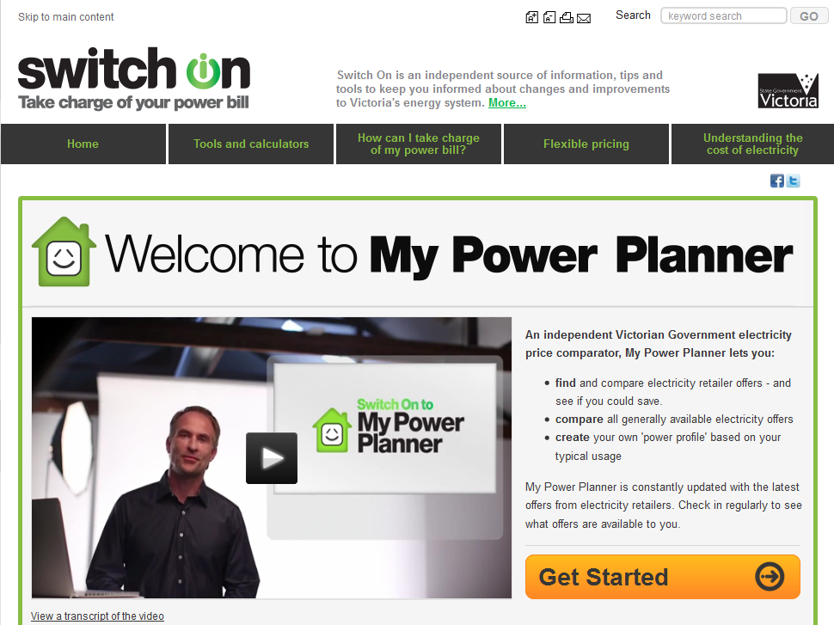
Choosing a Good Deal
Comparing Electricity Offers – mpp.switchon.vic.gov.au/
Notes:
Once you understand a bit about your bill you can use the My Power Planner website to help choose a great electricity deal
My Power Planner is an independent government run price comparison service for electricity
Other price comparison websites may have deals with specific retailers, so they don’t compare all of the offers to find you the very best deal
By answering a few questions My Power Planner will estimate the cost of different electricity deals
To start you will need a recent electricity bill, a computer and some information about your house

Slide 29
Choosing a Good Deal
Households can save up to
$330 - $410 a year on gas
by switching from the worst to the best offer
– St Vincent de Paul
Notes:
A recent report by St Vincent de Paul (http://www.vinnies.org.au/icms_docs/192728_Victorian_Energy_Prices.pdf) found that “gas customers with typical consumption (63,000Mj) can save up to $330 - $410 per annum (depending on their gas zone)” by switching from the worst to the best offer

Slide 30
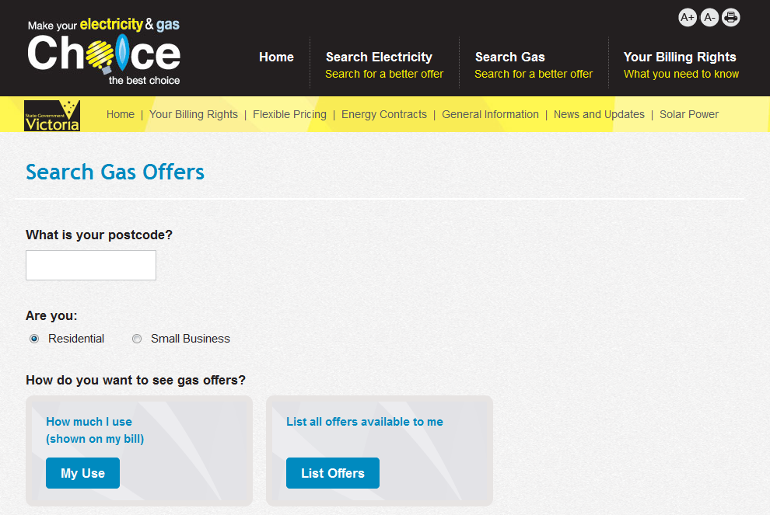
Choosing a Good Deal
Comparing Gas Offers- www.yourchoice.vic.gov.au/search/gas
Notes:
For gas, the independent government price comparison website is called YourChoice (in the future this information will also be on the My Power Planner website)
Like My Power Planner, YourChoice shows the cheapest deals at the top, and shows prices with and without discounts

Slide 31

Choosing a Good Deal
Checking the details
Will I be ‘locked in’ to the contract?
Will the price of electricity change?
How will I be billed?
How can I pay?
Is it a flexible pricing plan?
Notes:
Finding a lower price is probably your top priority, but there are other things to consider so check the details:
Will you be ‘locked in’ to a contract? With some companies you will have to pay an ‘exit fee’ if you want to change companies
Is the price of electricity going to change? Some energy companies will keep the price the same when you have a contract. Other companies will increase the price they charge. If you have a long contract and a high ‘exit fee’, there’s a risk that the price will go up and you will be stuck with an unsuitable deal
How are you billed? Some of the cheapest deals only come with e-mail bills, not paper ones sent through the post. You should only sign up to that type of plan if you have an email address and access to the internet
How can you pay? Some energy companies might charge extra to use some payment methods (such as direct debit) or may want you to pay monthly with automatic credit card payments
If you want to pay from your Centrelink payments make sure the deal lets you pay through Centrepay
If it is a ‘flexible pricing’ plan make sure you understand how this works and how it can work for you

Slide 32
Choosing a Good Deal
If you like the look of a new deal:
Call the energy company
Mention the name of the deal
Confirm you are eligible for the deal
Discuss any questions
If you are happy, the energy company will organise the rest
If you change your mind - you have a 10 day cooling off period
Notes:
First, check with the company sending you bills to see if you must pay an exit fee or if they’ll match the new deal
Say the name of the plan you want
You will also be asked for your name, address, phone number and birth date, as well as details for any extra account holders
The person from the energy company will read or play a recording of the terms and conditions and ask you whether they understand and agree to them. If you have questions or if anything is unclear, you should ask the operator about it
Don’t forget to give your concession card details, if you have one
The energy company will organise the rest – you do not need to contact your old energy company
Remember, it is ok to change your mind - you have a 10 day ‘cooling-off period’. During this time, if you change your mind you can contact the energy company to let them know

Slide 33
Door Knocking
You have rights
You can ask them to leave and they must:
Go immediately
Not return for 30 days
You can change your mind if you buy something:
You have a 10 day cooling off period
You can shop around during this time
Notes:
Remember, a door knocker will only give you information about deals at one energy company. It is much better to shop around yourself using My Power Planner, which will give you information about energy deals at all the energy companies.
It is ok to change your mind - you have a 10 day ‘cooling-off period’. During this time, if you change your mind you can contact the energy company to let them know

Slide 34

Door Knocking
Door to door sales people cannot visit:
On Sundays
Public Holidays
Before 9am or after 6pm Monday- Friday
Before 9am or after 5pm on Saturday
If you display a Do Not Knock sign
Notes:
To get a sticker:
visit http://donotknock.org.au/take-action/get-the-sticker-2/
or Send a stamped, self-addressed envelope to the following address. Ask for more for your friends if you wish.
Do Not Knock PO Box 16193 Collins Street West VIC 8007
** Why not shop around for a better electricity deal using My Power Planner rather than sign up with the person that knocks on your door or calls you on the phone?

Slide 35
Payment Difficulty
Ask for the Hardship Team:
Affordable plans
Referrals to free financial counsellors
Energy saving advice
Applying concessions and grants
Can I speak to your hardship team?
I’m in financial hardship and can’t afford to pay my bill now. Can you suggest a more affordable amount?
Notes:
Energy companies often have specialised hardship teams to assist people experiencing financial hardship
To access these schemes ask to speak with the hardship team or mention that you are experiencing hardship

Slide 36
Solving Problems
Step 1 – try to work it out with the company
Call the company. Explain the issue and ask how it can be fixed
Write down information about the call
Remember - if you’re not comfortable you can ask a friend, relative or community worker to talk for you
Notes:
If you have problems, try first to fix the issue with the company that sends your bills
Under Victorian law, consumers have rights and protections
It is important to write down the details of any phone calls, including the name of the person you or the client spoke to, the date and time of the call, and what was discussed and decided. This will be useful if you decide to make a complaint

Slide 37
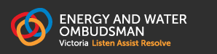
Solving Problems
Step 2 – call the Energy and Water Ombudsman
1800 500 509
Notes:
If unable to resolve the issue with the company that sends your bills – contact the Energy and Water Ombudsman Victoria (EWOV)
The Energy and Water Ombudsman acts as an ‘independent umpire’ – they are not for the customer or for the company and helps people to sort out problems with their energy and water companies
You can contact EWOV by calling 1800 500 509 between 8:30am and 5:00pm, Monday to Friday – it is a free call

Slide 38
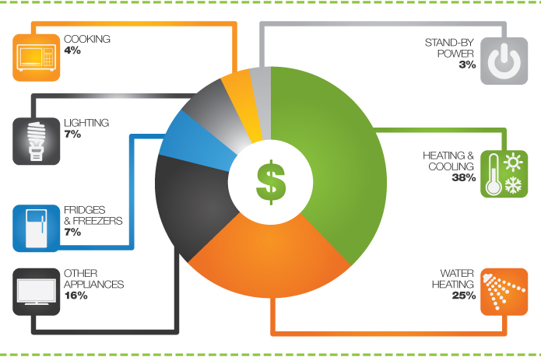
Saving Energy
Energy cost in a typical Victorian household
www.switchon.vic.gov.au
Notes:
You do not need to spend lots of money to save energy – there are many things you can do for free or for not much money but it is worth focusing on those items that will have the biggest impact on the amount of energy we use
Usually the biggest users of energy are the things that heat (for example, heating your home, heating your hot water, and drying your clothes) and the things that cool (for example, air-conditioning and refrigeration). These things use around 70% of all the energy in your home
Saving energy is about saving time. The goal is to get appliances to do their job in the quickest time possible. This is because you get get charged for how long you use each appliance
The next few pages show you some of the best things you can do to reduce the time your appliances run and save energy

Slide 39
Saving Energy
159 days below 18ºC
- Melbourne has more cold days than hot
Notes:
Heating uses much of the energy we pay for
Sustainability Victoria - http://www.sustainability.vic.gov.au/services-and-advice/households/energy-efficiency/toolbox/reports

Slide 40
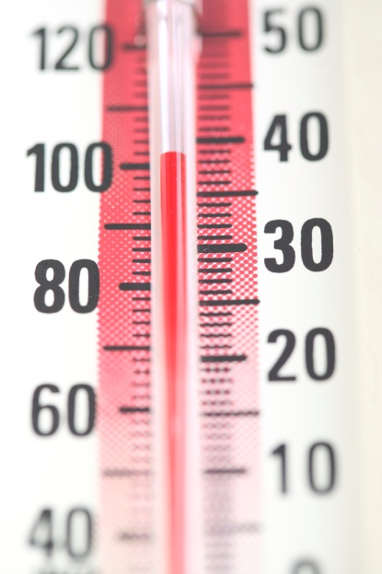
Saving Energy
Top tips - Heating
Don’t pay for heating you don’t need - heat your rooms to around 20ºC
Keep the heat you pay for inside the home – seal draughts and cover windows
Don’t pay to heat rooms you’re not using - close doors to unused rooms
Turn your heater off overnight or when going out
Notes:
Here is how you can stay warm at home and save energy:
Heating to hotter temperatures means the heater will run for a lot longer – costing you more money (remember you get charged for how long you use things). The idea is to heat the room you are in to a temperature that keeps you comfortable (when appropriately dressed!) and not too hot as this takes longer and wastes energy. Every extra 1ºC costs 10% more.
When added together, the gaps and cracks in many homes is equal to the size of a basketball! Think how much heat would escape in winter and how much hot air this lets in in summer. Door seals are cheap and can be bought from many hardware stores to seal the draughts around doors, windows, chimneys and vents to stop warm air escaping
Bigger areas cost more to heat than smaller areas. You can make your house smaller by closing doors to any areas you don’t use
Why pay for something you don’t need? Running a heater overnight or whilst out means the heater runs for a lot more of the day and costs a lot more money. It is a lot cheaper to turn the heater on when you first get up in the morning or come home

Slide 41
Saving Energy
35 days of 30ºC or above
- Melbourne is also quite hot!
Notes:
Sustainability Victoria - http://www.sustainability.vic.gov.au/services-and-advice/households/energy-efficiency/toolbox/reports

Slide 42
Saving Energy
Top tips - Cooling
Use low cost cooling – use a fan
Keep your house cool naturally – shade windows on the outside of the glass
Don’t pay for cooling you don’t need - cool rooms to around 26ºC
Turn your air-conditioner off when going out
Notes:
Here is how you can stay cool at home and save energy:
Fans they are around 20 to 40 times cheaper than air-conditioners. Fans usually use around 50W. A small air-conditioner uses around 1000W. That means you can run a fan for 20 hours for the same cost as running a small air-conditioner for just 1 hour (a 50W fan running for 20 hours would use 1000W)
For every square metre of glass facing the sun in summer it is the same as a single bar radiant heater heating through the glass. The best way to stop this heat is to put shading on the outside of the glass
Air-conditioning to colder temperatures means the air-conditioner will run for a lot longer – costing you more money (remember you get charged for how long you use things). The idea is that when using an air-conditioner you cool the room you are in to a temperature that keeps you comfortable (when appropriately dressed!) and not too cold as this takes longer and wastes energy. Every extra 1ºC of cooling costs 10% more
Don’t pay to cool a house or room that you are not using

Slide 43
Saving Energy
Hot water is one of the areas where most energy is used
Notes:
Home heating and hot water use the most energy
http://www.sustainability.vic.gov.au/services-and-advice/households/energy-efficiency/toolbox/reports

Slide 44
Saving Energy
Top tips – Hot Water
Use a water saving shower head
Try to keep your showers to around 5 minutes or less
Wash your clothes in cold water
Notes:
Water saving shower heads use around half the amount of water as old-fashioned shower heads. Water saving shower heads are really good now and you often cannot tell that they use less water
Showers use a lot of the home’s hot water. Shorter showers mean that less water needs to be reheated – saving you money
Washing clothes in cold water is around half the cost of washing clothes in warm water (sometimes more)

Slide 45
Saving Energy
Fridges use about 18% of all electricity in the house
Notes:
http://www.sustainability.vic.gov.au/services-and-advice/households/energy-efficiency/toolbox/reports

Slide 46
Saving Energy
Top tips – Fridge & Freezers
Food stays fresh in a fridge at 3 to 5ºC, colder temperatures cost more
Food stays fresh in a freezer at -15ºC to -18ºC
Fridges and freezers will cost less if kept cool away from the sun or heaters and ventilated
Turn off second fridges or freezers when you don’t need them
Notes:
Food stays fresh in a fridge and freezer at these temperatures. If the temperature is colder the fridge or freezer will run for longer and cost more money
Fridges and freezers need to stay cool. If they get hot they run for longer and cost more money
It’s much cheaper to run one fully loaded fridge or freezer than it is to run two half empty units. So, if you don't have much in your second fridge or freezer turn it off and put the goods in your main fridge or freezer

Slide 47
Energy Saving Quiz
Is it cheaper to turn a heater off or leave it running while you’re out?
– it is always cheaper to turn a heater off when leaving as you get charged for how long you use appliances
2. On a hot day, is it better to close your curtains or put some shading up outside?
– it is much better to put shading up outside
3. Which is cheaper a fan or an air-conditioner?
– a fan is about 20 to 40 times cheaper
4. Is it cheaper to wash clothes in warm or cold water?
– washing clothes in cold water is cheaper
5. What temperature is best to keep food fresh in a fridge?
– between 3ºC and 5ºC

Slide 48
Energy Saving Quiz
6. How much energy does heating and cooling use in the average house? Is it 10%, 25%, or 40%?
– 40% of the energy you use goes towards heating and cooling
7. What temperature is recommended for heating your home?
– 20ºC or whatever is comfortable. Remember every 1ºC extra costs more!
8. What is best to do with 2 half full fridges?
– fill one up fully and turn the other one off until you need it
9. What is a good time to aim for to save energy in the shower?
– around 5 minutes or less
10. Why seal draughts when the gaps are usually so small?
– when added together the gaps are big and cause you to loose warm air that you’ve paid for

Slide 49
Questions?

