Slide 1
Balance
There are two types of balance:
Static ( when you are standing still )
Dynamic ( when you are moving)

Slide 2
Benign Paroxysmal Positional Vertigo
(BPPV)
BPPV occurs when CaCO3 crystals- motion sensors (otoconia) that are normally embedded in gel in the utricle become dislodged & migrate into one or more of the 3 fluid filled semicircular canals , where they are not supposed to be , causing episode of vertigo triggered by movement & changes in position

Slide 3
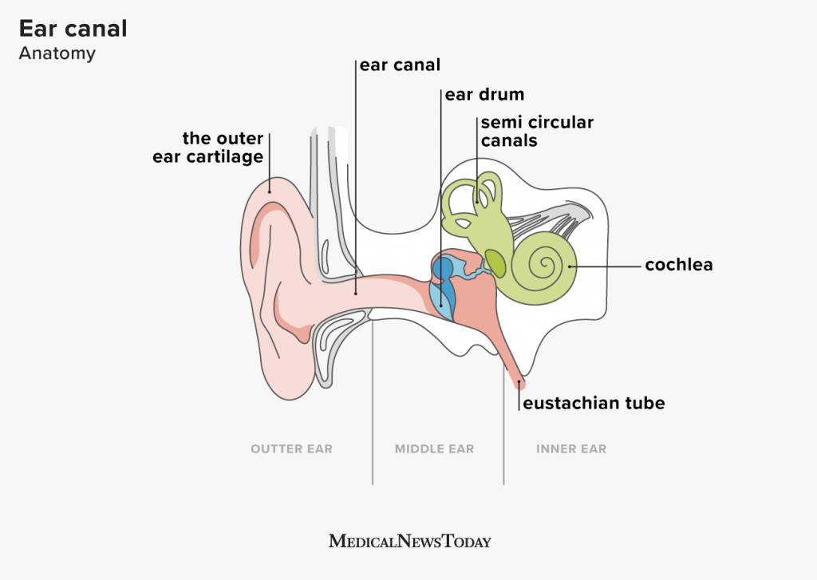

Slide 4
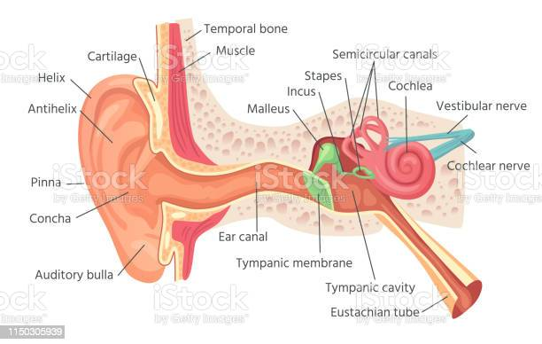

Slide 5
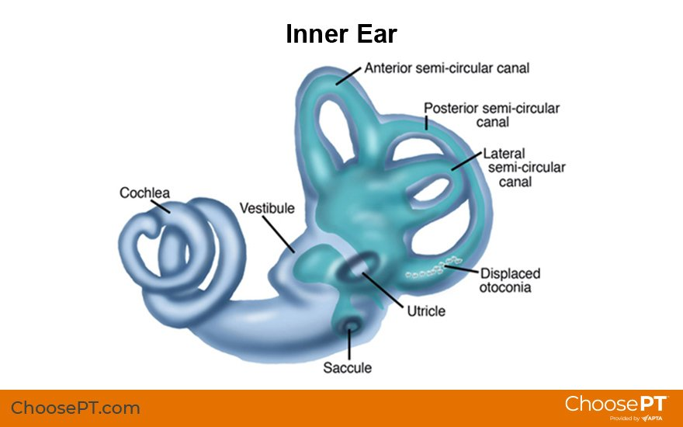

Slide 6
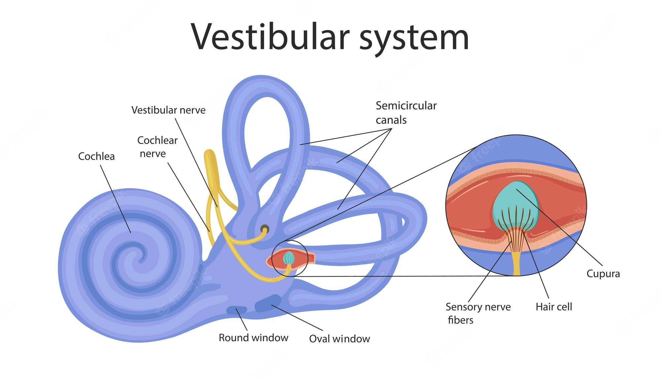

Slide 7
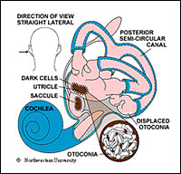
Inner ear

Slide 8
Brain structure

Slide 9
Lobe functions

Slide 10
Cerebellum
Maintenance of balance , posture and co-ordination. The cerebellum is important for making postural adjustments in order to maintain balance.

Slide 11
Balance/ strength/walking
Incorporate balance/ strength/walking activities into your everyday tasks and life routines
Balance exercises /strengthening exercises /walking would make it easier for you to do the house hold chores & you will stay independent
Balance & strength will help prevent falls
Strength will improve your balance
Walking will improve balance, you will feel better, have more energy

Slide 12
Balance /strength/walking
Keep progressing to more challenging activities
You should let go if necessary but keep up the flow
Load your muscles whenever you can

Slide 13
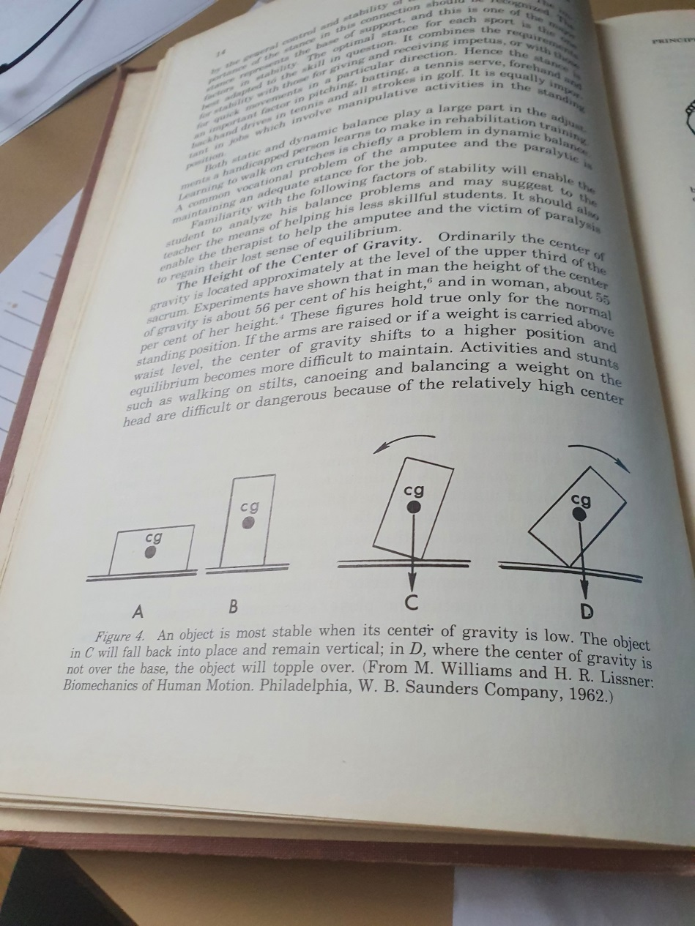

Slide 14
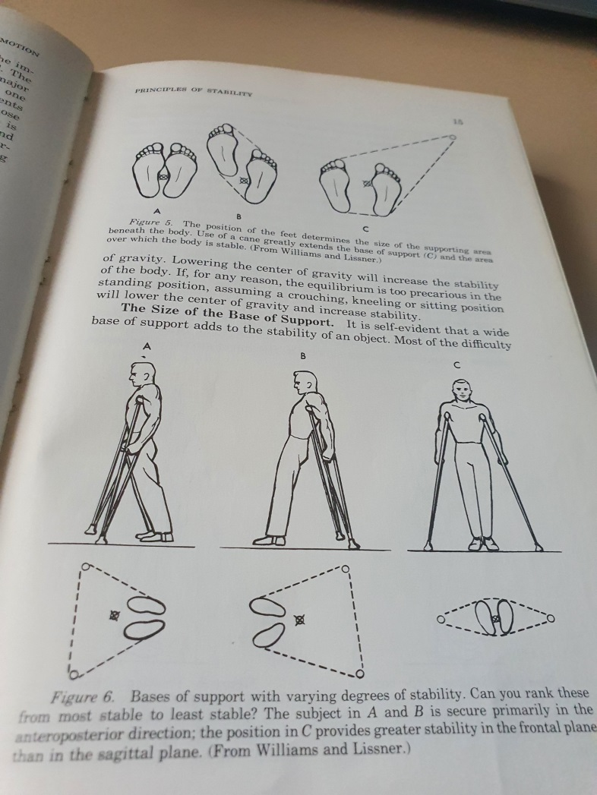

Slide 15
Principles of improving your balance
Reducing your base of support (BOS)- all parts of you that are in contact with the floor. If you are standing & holding onto a table , your hands & feet are your BOS. As you reduce your BOS you increase the difficulty of balancing
Shifting weight & moving to the limits of stability – for good balance you need to be able to keep your stability when you shift your weight as you move. If you can smoothly & safely shift your weight in either a sideways, forwards & backwards direction then you will be less likely to lose your balance
Safely & confidently stepping over objects is important when dealing with obstacles like gutters & uneven surface

Slide 16
Balance activities ( get active & use support if needed)
Tandem stand- stand with one foot in front of the other ( heel to toe)
Tandem walk – heel to toe walking
One leg stand – stand on one leg while holding the other leg off the floor
Leaning side to side – stand with your weight evenly distributed on both feet. Shift your body weight so that it is mostly on one foot & hold for a few seconds at the limit of the shift. You should not bend at the waist. Once you finish with one leg, shift the weight to the other foot.

Slide 17
Balance activities ( get active – use support if needed)
Leaning forwards and backwards - stand with your weight evenly distributed on both feet. Shift weight forward onto your toes with out losing your balance & hold at that point for a few seconds, then shift your weight backwards on to your heels & hold there for a few seconds.
Stepping over objects – forwards & backwards, lift your leg up & over as you lift the leg that is doing the stepping, you will need to balance on the leg that you are standing on. When you have stepped over forwards you should try to do it backwards.
Stepping over objects side to side – practice in sideways direction

Slide 18
Challenging your balance
Tandem walking with eyes closed
Tandem stand & shifting weight forwards and backwards

Slide 19
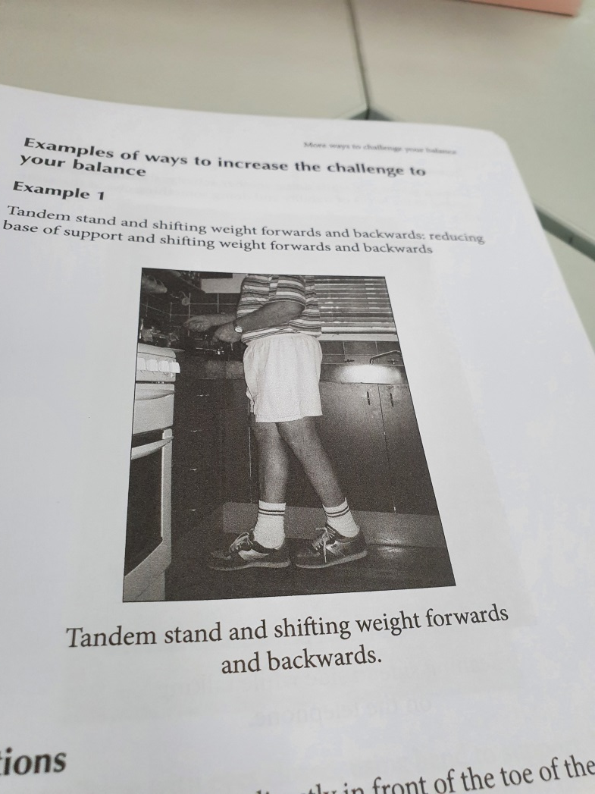

Slide 20
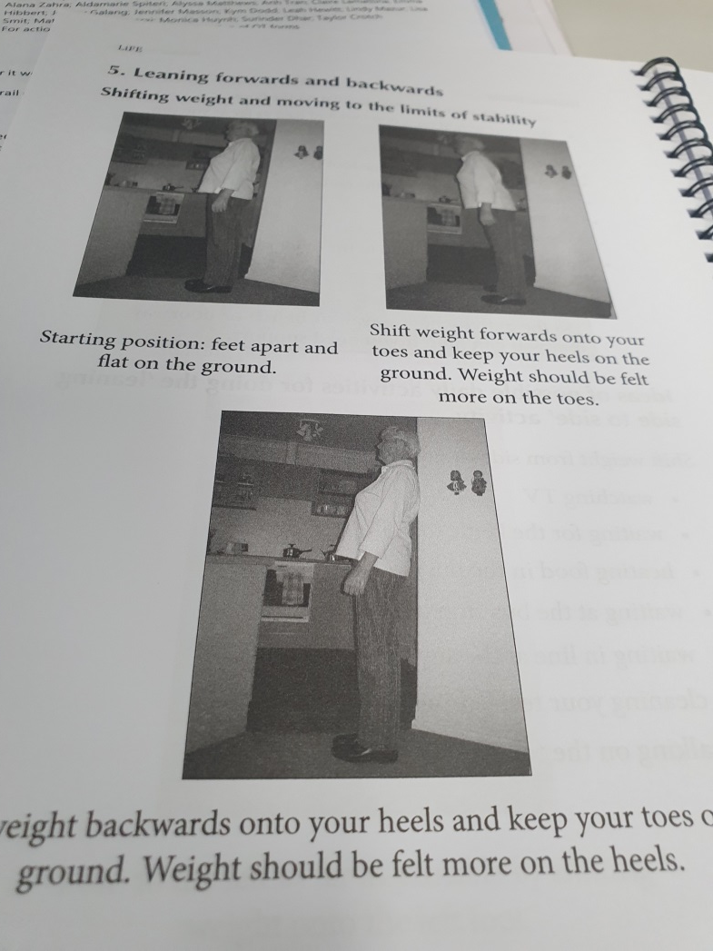

Slide 21
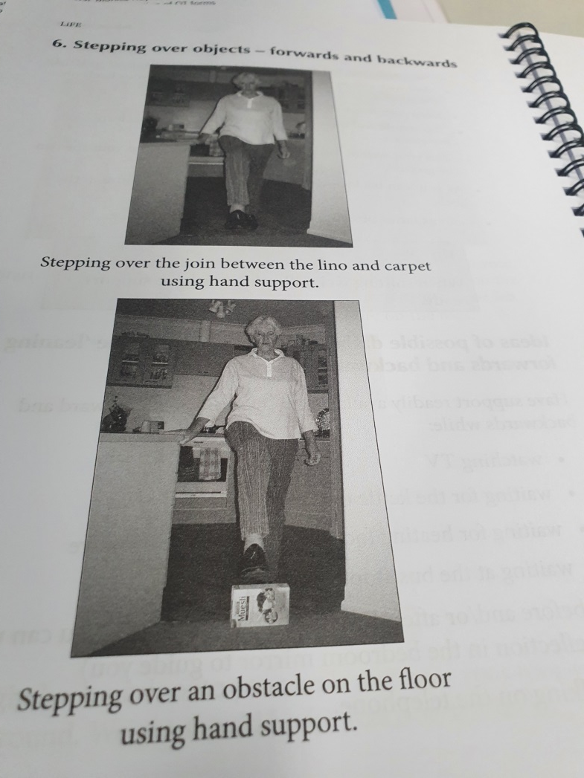

Slide 22
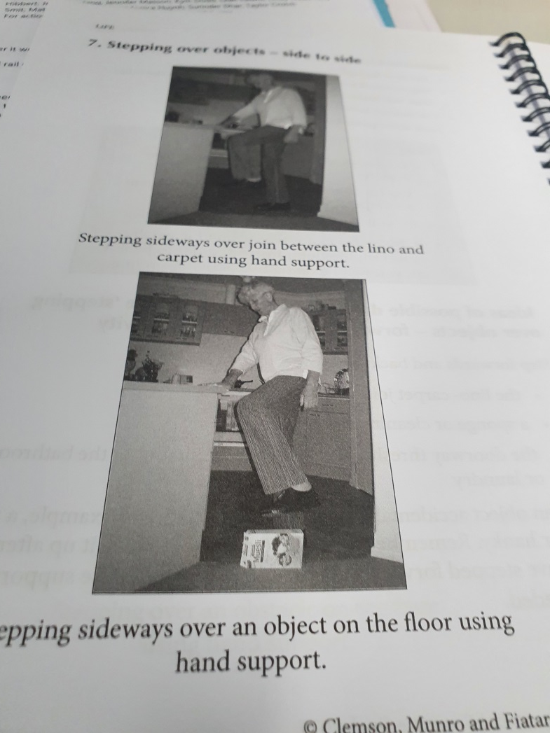

Slide 23
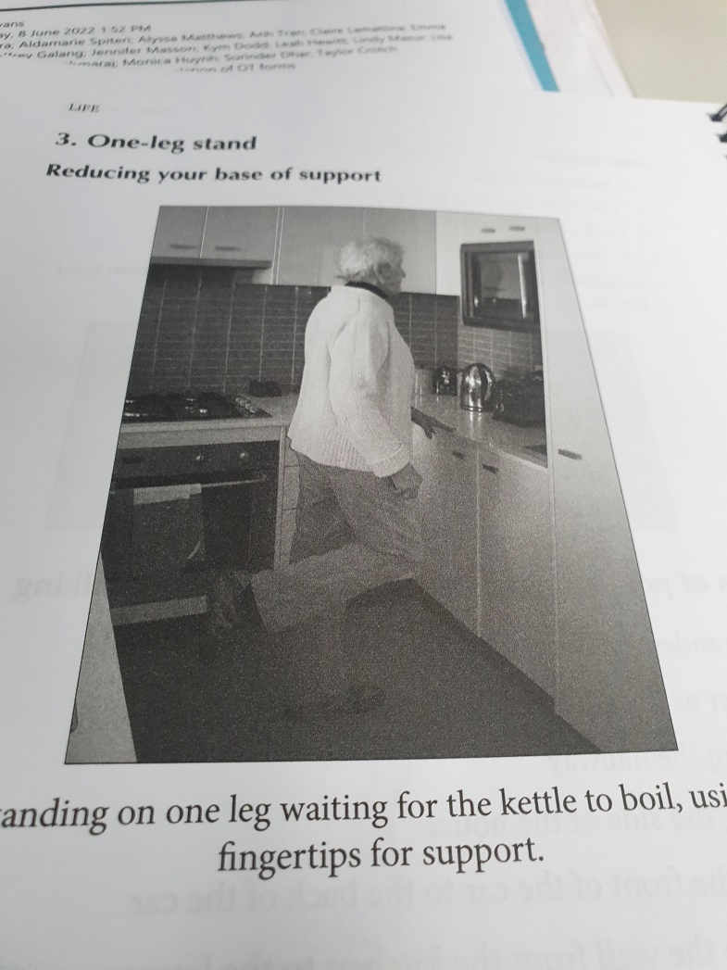

Slide 24
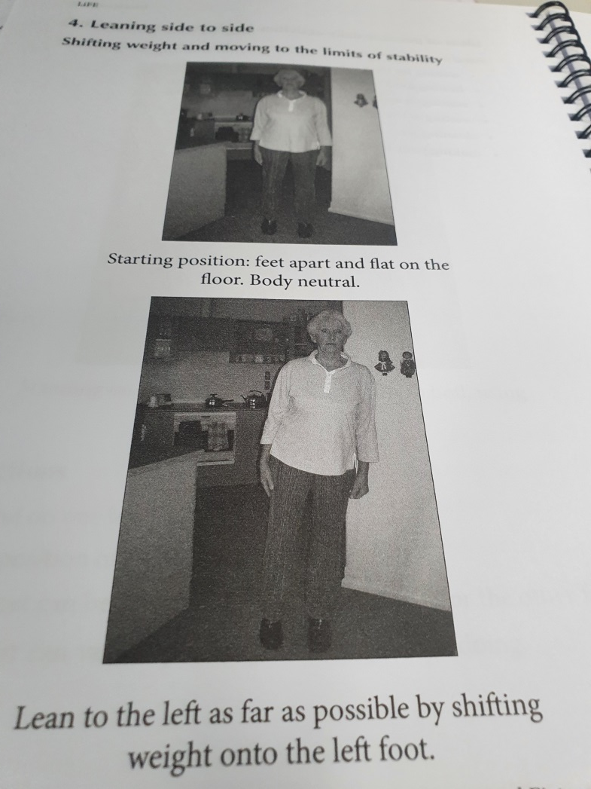

Slide 25
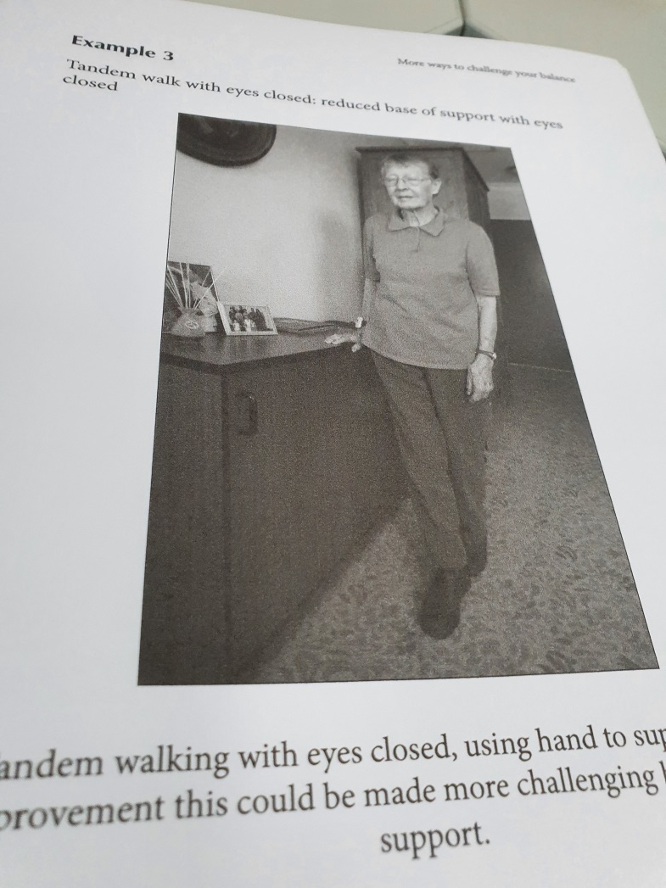

Slide 26
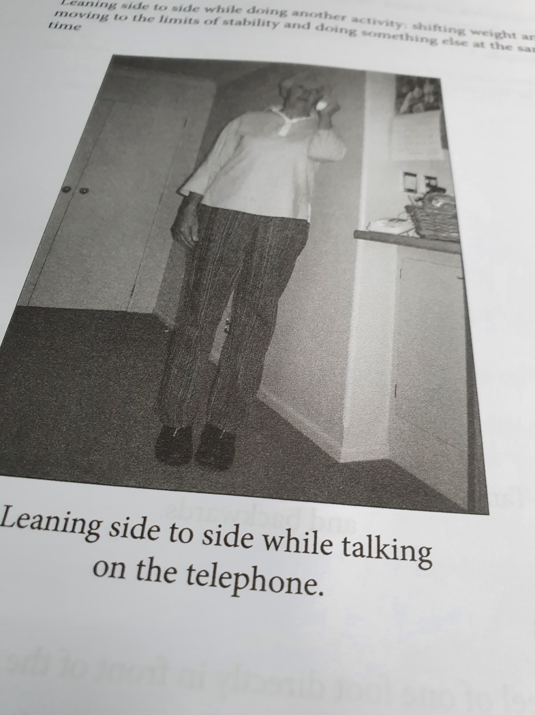

Slide 27
Disclaimer
The above information has been provided in an advisory capacity and should not be construed as a recommendation.

